Slide 1
What is an Operating System (1)?
A modern computer consists of:
One or more processors
Main memory
Disks
Printers
Various input/output devices.
Managing all these varied components requires a layer of software – the Operating System (OS).
Notes:
1

Slide 2
What is an Operating System (2)?
An Operating System is a program that acts as an intermediary/interface between a user of a computer and the computer hardware.
OS goals:
Control/execute user/application programs.
Make the computer system convenient to use.
Ease the solving of user problems.
Use the computer hardware in an efficient manner.
Notes:
2

Slide 3
Services provided by an OS
Facilities for program creation
editors, compilers, linkers, debuggers, etc.
Program execution
loading in memory, I/O and file initialization.
Access to I/O and files
deals with the specifics of I/O and file formats.
System access
resolves conflicts for resource contention.
protection in access to resources and data.
Notes:
3

Slide 4
What Operating Systems Do
Depends on the point of view.
Users want convenience, ease of use and good performance
Don’t care about resource utilization.
But a shared computer such as mainframe or minicomputer must keep all users happy.
Users of dedicate systems such as workstations have dedicated resources but frequently use shared resources from servers.
Handheld computers are resource poor, optimized for usability and battery life.
Some computers have little or no user interface, such as embedded computers in devices and automobiles.
A. Frank - P. Weisberg
Notes:
4

Slide 5
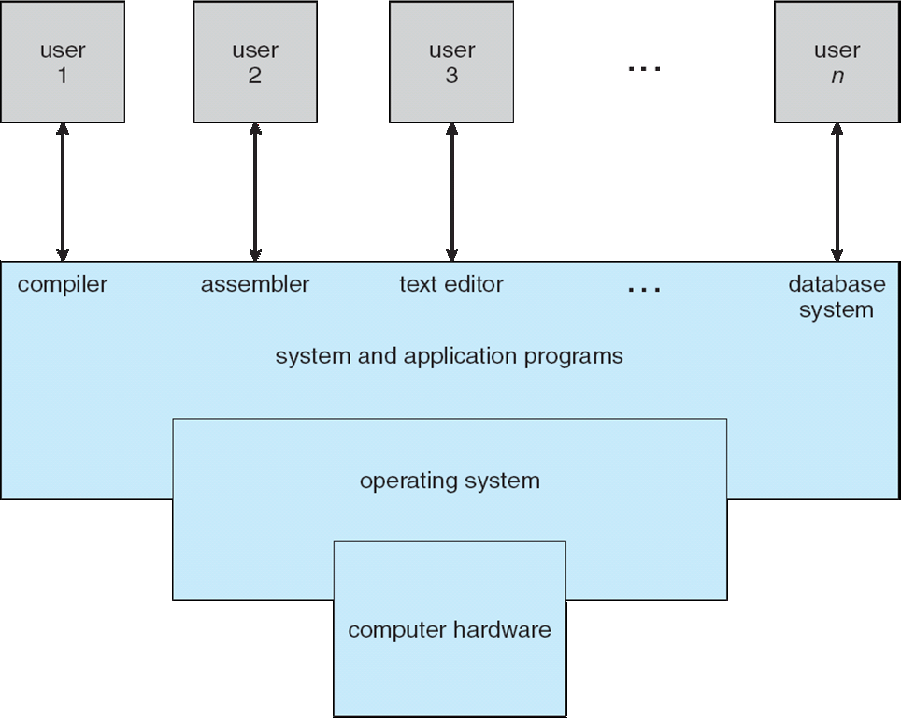
Static View of System Components
Notes:
5

Slide 6
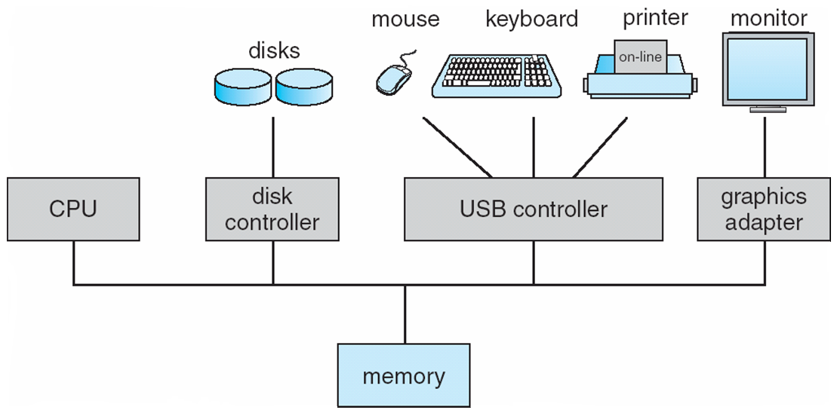
Computer System Organization
Computer-system operation
One or more CPUs, device controllers connect through common bus providing access to shared memory
Concurrent execution of CPUs and devices competing for memory cycles
To ensure orderly access to the shared memory, a memory controller synchronizes access to the memory.

Slide 7
Computer-system operation
When a computer powered up or rebooted—it needs to have an initial program to run.
This initial program, or bootstrap program, tends to be simple.
Typically, it is stored within the computer hardware in read-only memory (ROM) or electrically erasable programmable read-only memory (EEPROM), known by the general term firmware.
It initializes all aspects of the system, from CPU registers to device controllers to memory contents.
The bootstrap program must know how to load the operating system and how to start executing that system.

Slide 8
Kernel
Several resources are managed by the OS.
A portion of the OS resides in the main memory.
This includes the kernel, which contains the most frequently used functions in the OS and, at a given time, other portions of the OS currently in use.
The remainder of main memory contains user and utility programs and data.
The OS and the memory management hardware in the processor jointly control the allocation of main memory

Slide 9
Computer-system operation …
Once the kernel is loaded and executing, it can start providing services to the system and its users.
Some services are provided outside of the kernel, by system programs that are loaded into memory at boot time to become system processes, or system daemons that run the entire time the kernel is running.
On UNIX, the first system process is “init,” and it starts many other daemons.
Once this phase is complete, the system is fully booted, and the system waits for some event to occur.
An operating system is interrupt driven.

Slide 10
Computer-system operation …
The occurrence of an event is usually signaled by an interrupt from either the hardware or the software.
Hardware may trigger an interrupt at any time by sending a signal to the CPU, usually by way of the system bus.
Software may trigger an interrupt by executing a special operation called a system call (also called a monitor call).

Slide 11
Common Functions of Interrupts
Interrupt transfers control to the interrupt service routine generally, through the interrupt vector, which contains the addresses of all the service routines
Interrupt architecture must save the address of the interrupted instruction
A trap or exception is a software-generated interrupt caused either by an error or a user request

Slide 12
Interrupt Mechanism
When the CPU is interrupted, it stops what it is doing and immediately transfers execution to a fixed location.
The fixed location usually contains the starting address where the service routine for the interrupt is located.
The interrupt service routine executes; on completion, the CPU resumes the interrupted computation.
The interrupt must transfer control to the appropriate interrupt service routine.
However, interrupts must be handled quickly.

Slide 13
Interrupt Mechanism
Generally, the table of pointers is stored in low memory (the first hundred or so locations).
These locations hold the addresses of the interrupt service routines for the various devices.
This array, or interrupt vector, of addresses is then indexed by a unique device number, given with the interrupt request, to provide the address of the interrupt service routine for the interrupting device.

Slide 14
Interrupt Mechanism
The interrupt architecture must also save the address of the interrupted instruction.
After the interrupt is serviced, the saved return address is loaded into the program counter, and the interrupted computation resumes as though the interrupt had not occurred.

Slide 15
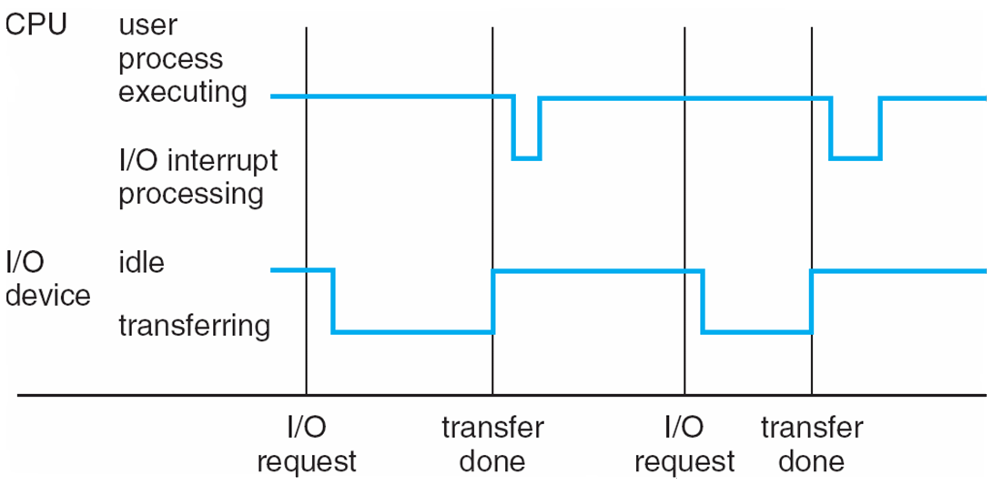
Interrupt Timeline

Slide 16
Computer-System Operation
I/O devices and the CPU can execute concurrently
Each device controller is in charge of a particular device type
Each device controller has a local buffer
CPU moves data from/to main memory to/from local buffers
I/O is from the device to local buffer of controller
Device controller informs CPU that it has finished its operation by causing an interrupt

Slide 17
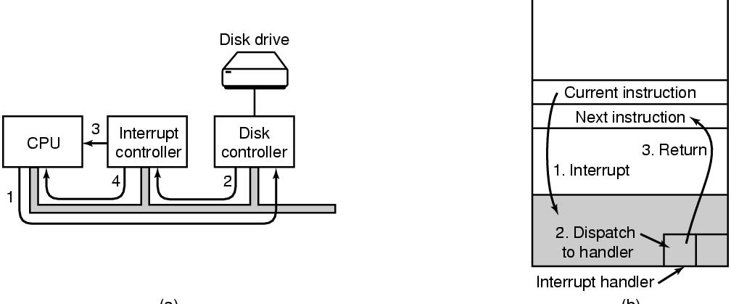
I/O by Interrupts
Generate an interrupt when I/O is finished.
e.g. When character is finished being printed, interrupt CPU. Allows CPU to do something else while character is being printed
Tanenbaum, Modern Operating Systems 3 e, (c) 2008 Prentice-Hall, Inc. All rights reserved. 0-13-6006639

Slide 18
Operating System Timeline
First generation: 1945 – 1955
Vacuum tubes
Plug boards
Second generation: 1955 – 1965
Transistors
Batch systems
Third generation: 1965 – 1980
Integrated circuits
Multiprogramming
Fourth generation: 1980 – present
Large scale integration
Personal computers
Next generation: ???
Systems connected by high-speed networks?
Wide area resource management?

Slide 19
First generation: direct input
Run one job at a time
Enter it into the computer (might require rewiring!)
Run it
Record the results
Problem: lots of wasted computer time!
Computer was idle during first and last steps
Computers were very expensive!
Goal: make better use of an expensive commodity: computer time
CS 1550, cs.pitt.edu (originaly modified by Ethan L. Miller and Scott A. Brandt)

Slide 20
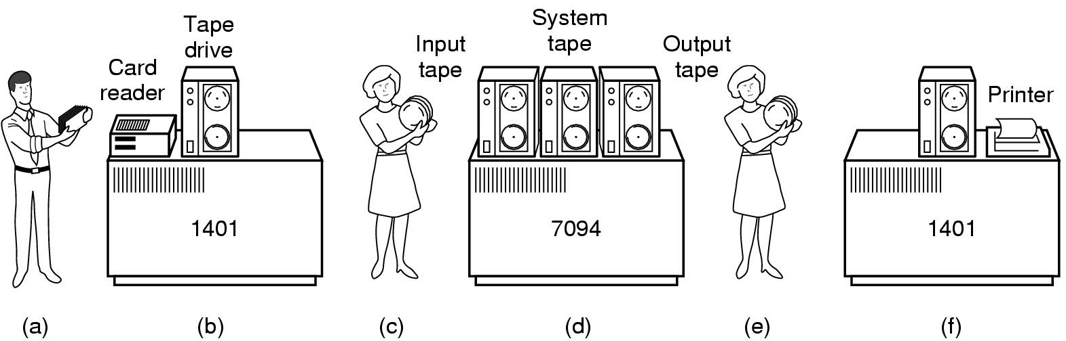
Second generation: batch systems
Bring cards to 1401
Read cards onto input tape
Put input tape on 7094
Perform the computation, writing results to output tape
Put output tape on 1401, which prints output
Chapter 1

Slide 21
Spooling
Original batch systems used tape drives
Later batch systems used disks for buffering
Operator read cards onto disk attached to the computer
Computer read jobs from disk
Computer wrote job results to disk
Operator directed that job results be printed from disk
Disks enabled simultaneous peripheral operation on-line (spooling)
Computer overlapped I/O of one job with execution of another
Better utilization of the expensive CPU
Still only one job active at any given time
CS 1550, cs.pitt.edu (originaly modified by Ethan L. Miller and Scott A. Brandt)

Slide 22
Third generation: multiprogramming
Multiple jobs in memory
Protected from one another
Operating system protected from each job as well
Resources (time, hardware) split between jobs
Still not interactive
User submits job
Computer runs it
User gets results minutes (hours, days) later
Job 3
Job 2
Memory partitions
Job 1
Operating system

Slide 23
Timesharing
Multiprogramming allowed several jobs to be active at one time
Initially used for batch systems
Cheaper hardware terminals -> interactive use
Computer use got much cheaper and easier
No more “priesthood”
Quick turnaround meant quick fixes for problems

Slide 24
Views of an Operating System
There are three classical views (in literature):
Resource Manager – manages and allocates resources.
Control program – controls the execution of user programs and operations of I/O devices.
Command Executer – Provides an environment for running user commands.
But one more modern view: Operating System as a Virtual Machine.
A. Frank - P. Weisberg
Notes:
24

Slide 25
Operating System as a Resource Manager
Allow multiple programs to run at the same time
Manage and protect memory, I/O devices, and other resources
Manages and protects multiple computer resources: CPU, Processes, Internal/External memory, Tasks, Applications, Users, Communication channels, etc…
Handles and allocates resources to multiple users or multiple programs running at the same time and space (e.g., processor time, memory, I/O devices).
Tanenbaum, Modern Operating Systems 3 e, (c) 2008 Prentice-Hall, Inc. All rights reserved. 0-13-6006639

Slide 26
Resource Manager oriented OS names
DEC RSX – Resource Sharing eXecutive
MIT Multics – MULTiplexed Information and Computing Services
IBM MFT/MVT – Multiple Fixed/Variable Tasks
IBM MVS – Multiple Virtual Storage
DEC VMS – Virtual Memory System
MVS TSO – Time Sharing Option
CTSS – Compatible Time Sharing System
IBM VM – Virtual machine
A. Frank - P. Weisberg
Notes:
26

Slide 27
2. Control Program
Control Program:
Manages all the components of a complex computer system in an integrated manner.
Controls the execution of user programs and I/O devices to prevent errors and improper use of computer resources.
Looks over and protects the computer: Monitor, Supervisor, Executive, Controller, Master, Coordinator ….
Notes:
27

Slide 28
Control program oriented OS names
Unisys MCP – Master Control Program
DR CP/M – Control Program/Microcomputer
IBM VM/CP – VM Control Program
IBM AIX – Advanced Interactive eXecutive
DEC RSX – Resource Sharing eXecutive
A. Frank - P. Weisberg
Notes:
28

Slide 29
3. Command Executer
Command Executer:
Interfaces between the users and machine.
Supplies services/utilities to users.
Provides the users with a convenient CLI (Command Language Interface), also called a Shell (in UNIX), for entering the user commands.
A. Frank - P. Weisberg
Notes:
29

Slide 30
Command Executer oriented OS names
IBM AIX – Advanced Interactive Executive
IBM VM/CMS – Conversational monitor System
A. Frank - P. Weisberg
Notes:
30

Slide 31
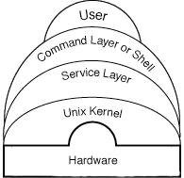
UNIX System Layout
A. Frank - P. Weisberg
Notes:
31

Slide 32
Storage Structure
Ideally, we want the programs and data to reside in main memory permanently.
This arrangement usually is not possible for the following two reasons:
Main memory is usually too small to store all needed programs and data permanently.
Main memory is a volatile storage device that loses its contents when power is turned off or otherwise lost.

Slide 33
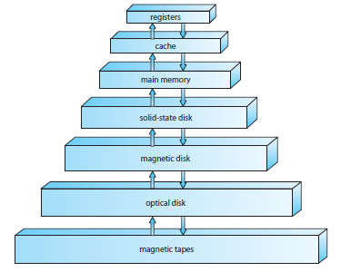
Various Storage Systems
The main differences among the various storage systems lie in speed, cost, size, and volatility.
The wide variety of storage systems can be organized in a hierarchy according to speed and cost.
The higher levels are expensive, but they are fast.
As we move down the hierarchy, the cost per bit generally decreases, whereas the access time generally increases.

Slide 34
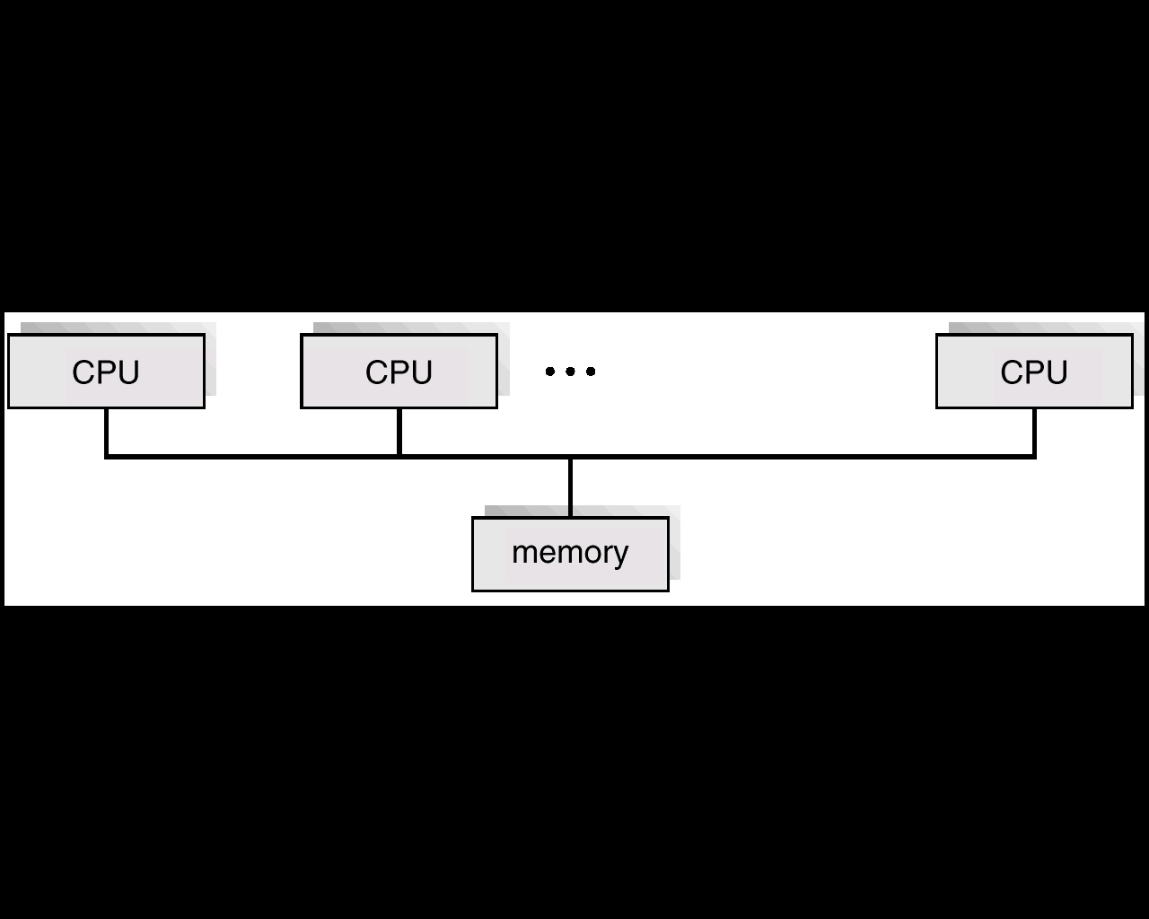
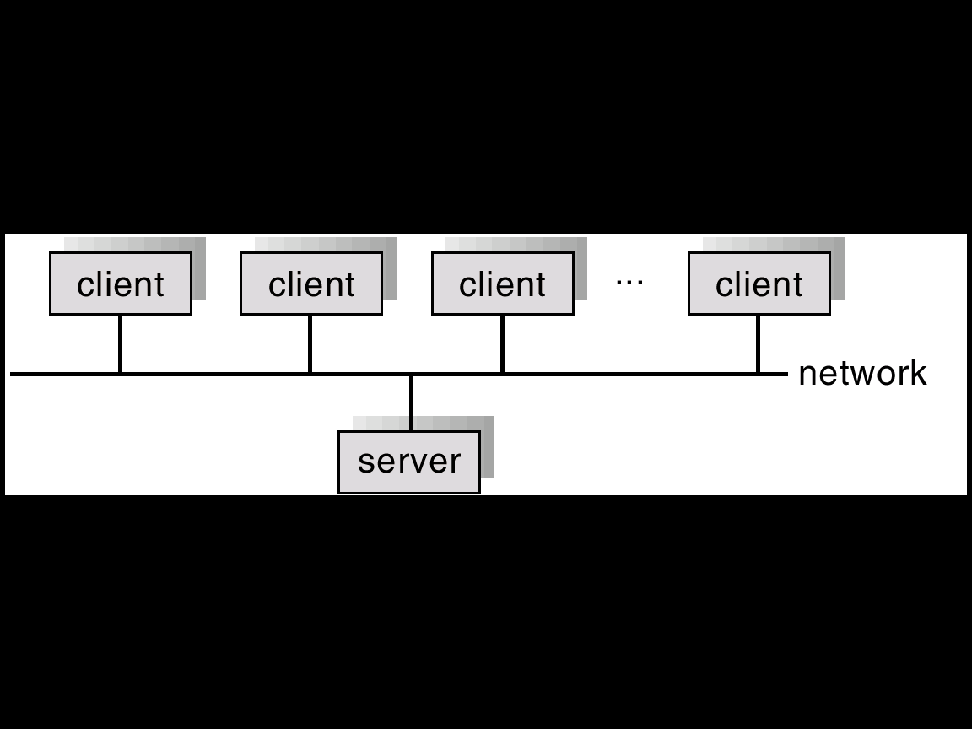
OPERATING SYSTEM OVERVIEW: Characteristics
Time Sharing - multiprogramming environment that's also interactive.
Multiprocessing - Tightly coupled systems that communicate via shared memory. Used for scientific applications. Used for speed improvement by putting together a number of off-the-shelf processors.
Distributed Systems - Loosely coupled systems that communicate via message passing. Advantages include resource sharing, speed up, reliability, communication.
Real Time Systems - Rapid response time is main characteristic. Used in control of applications where rapid response to a stimulus is essential.

Slide 35
Multiprocessor Systems
Multiprocessor systems first prominently appeared in servers and have since migrated to desktop and laptop systems.
Recently, multiple processors have appeared on mobile devices such as smartphones and tablet computers.

Slide 36
Multiprocessor System: Advantages
Increased throughput. By increasing the number of processors, we expect to get more work done in less time.
Economy of scale. Multiprocessor systems can cost less than equivalent multiple single-processor systems, because they can share peripherals, mass storage, and power supplies.
Increased reliability. If functions can be distributed properly among several processors, then the failure of one processor will not halt the system, only slow it down.

Slide 37
Features
Increased reliability of a computer system is crucial in many applications.
The ability to continue providing service proportional to the level of surviving hardware is called graceful degradation.
Some systems go beyond graceful degradation and are called fault tolerant, because they can suffer a failure of any single component and still continue operation.
Fault tolerance requires a mechanism to allow the failure to be detected, diagnosed, and, if possible, corrected.
The HP NonStop (formerly Tandem) system uses both hardware and software duplication to ensure continued operation despite faults.

Slide 38
Multiprocessing System Types
Asymmetric: Master-Slave
Symmetric (SMP): Each processor performs all tasks within the operating system.
SMP means that all processors are peers
An example of an SMP system is AIX, a commercial version of UNIX designed by IBM.
An AIX system can be configured to employ dozens of processors.
The benefit of this model is that many processes can run simultaneously—N processes can run if there are N CPUs—without causing performance to deteriorate significantly.
Multiprocessing adds CPUs to increase computing power. If the CPU has an integrated memory controller, then adding CPUs can also increase the amount of memory addressable in the system.

Slide 39
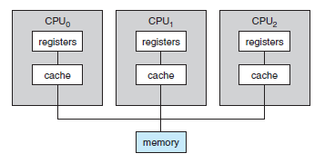
SMP vs Asymmetric
Sun Microsystems’ operating system SunOS Version 4 provided asymmetric multiprocessing, whereas Version 5 (Solaris) is symmetric on the same hardware. (Software decides)
Hardware may also decide SMP/Asymmetric.

Slide 40
Recent OS Design Requirements
A recent trend in CPU design is to include multiple computing cores on a single chip.
Such multiprocessor systems are termed multicore.
They can be more efficient than multiple chips with single cores because on-chip communication is faster than between-chip communication.
In addition, one chip with multiple cores uses significantly less power than multiple single-core chips.
It is important to note that while multicore systems are multiprocessor systems, not all multiprocessor systems are multicore.

Slide 41
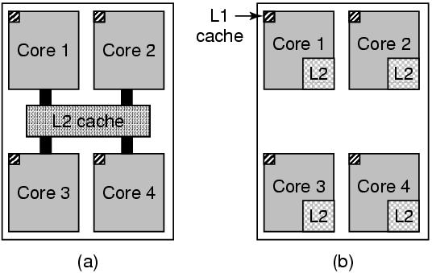
Multithreaded and Multicore Chips
(a) A quad-core chip with a shared L2 cache. (b) A quad-core chip with separate L2 caches.
Tanenbaum, Modern Operating Systems 3 e, (c) 2008 Prentice-Hall, Inc. All rights reserved. 0-13-6006639

Slide 42
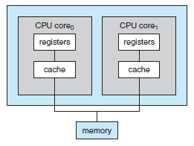
Dual Core Design
Each core has its own register set as well as its own local cache.
Other designs might use a shared cache or a combination of local and shared caches.
Aside from architectural considerations, such as cache, memory, and bus contention, multicore CPUs appear to OS as N standard processors.

Slide 43
Types of modern operating systems
Mainframe operating systems: MVS
Server operating systems: FreeBSD, Solaris
Multiprocessor operating systems: Cellular IRIX
Personal computer operating systems: Windows, Unix
Real-time operating systems: VxWorks
Embedded operating systems
Smart card operating systems
Some operating systems can fit into more than one category
Notes:
43
Got here on the first day of class.

Slide 44
Blade Servers
Blade servers are a relatively recent development in which multiple processor boards, I/O boards, and networking boards are placed in the same chassis.
The difference between these and traditional multiprocessor systems is that each blade-processor board boots independently and runs its own operating system.
Some blade-server boards are multiprocessor as well

Slide 45
Clustered Systems
Gathers together multiple CPUs.
Loosely Coupled System
Purpose is to provide high availability
High availability is provided by adding a level of redundancy in the system.
A layer of cluster software runs on the cluster nodes.
Each node can monitor one or more of the others (over the LAN).
If the monitored machine fails, the monitoring machine can take ownership of its storage and restart the applications that were running on the failed machine.

Slide 46
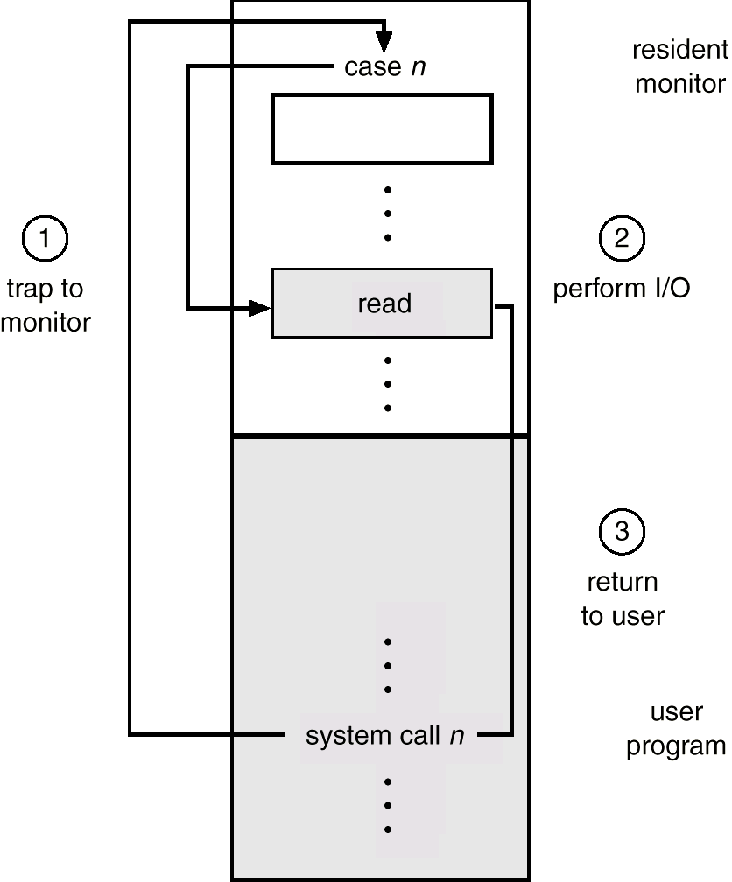
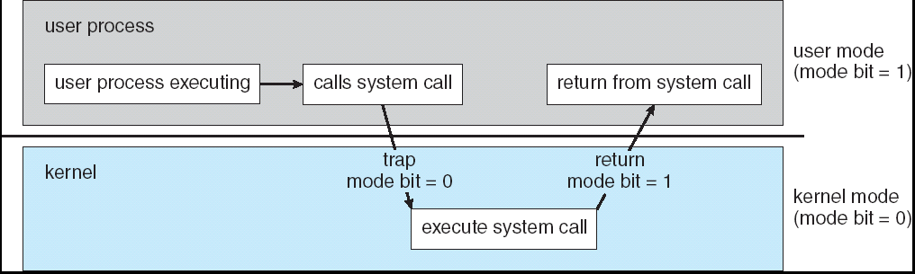
Dual Mode of Operation
Protection
The goal is protecting the Operating System and others from malicious or ignorant users.
The User/Kernel Mode and Privileged instructions.
At system boot time, the hardware starts in kernel mode.
The operating system is then loaded and starts user applications in user mode.

Slide 47
Dual Mode of Operation
Kernel mode is also called supervisor mode, system mode, or privileged mode.
A bit, called the mode bit, is added to the hardware of the computer to indicate the current mode: kernel (0) or user (1).
With the mode bit, we can distinguish between a task that is executed on behalf of the operating system and one that is executed on behalf of the user.
The hardware allows privileged instructions to be executed only in kernel mode.
If an attempt is made to execute a privileged instruction in user mode, the hardware does not execute the instruction but rather treats it as illegal and traps it to the operating system.

Slide 48
Dual Mode of Operation
Concurrent threads might interfere with others.
This leads to protection of resources by user/supervisor mode.
I/O Define I/O instructions as privileged; they can be executed only in Supervisor mode.
System calls get us from user to supervisor mode.

Slide 49
Operating System Structure
The CPU is wasted if a job waits for I/O.
This leads to: Multiprogramming (dynamic switching):
While one job waits for a resource, the CPU can find another job to run. It means that several jobs are ready to run and only need the CPU in order to continue.
By multiprogramming the CPU time is not wasted, because, while one process moves on some I/O work, the OS picks another process to execute till the current one passes to I/O operation.
Multiprogramming increases CPU utilization by organizing jobs (code and data) so that the CPU always has one to execute.

Slide 50
I/O Structure
After I/O starts, control returns to user program only upon I/O completion
Wait instruction idles the CPU until the next interrupt
Wait loop (contention for memory access)
At most one I/O request is outstanding at a time, no simultaneous I/O processing
After I/O starts, control returns to user program without waiting for I/O completion
System call – request to the OS to allow user to wait for I/O completion
Device-status table contains entry for each I/O device indicating its type, address, and state
OS indexes into I/O device table to determine device status and to modify table entry to include interrupt

Slide 51
I/O Devices
Controller runs a device-accepts commands from the OS and executes them
Complicated business
e.g. gets command to read sector x on disk y. Must convert to (cylinder, sector, head) address, move arm to correct cylinder, wait for sector to rotate under the head, read and store bits coming off the drive, compute checksum, store bits as words in memory
Controller contains a computer to run its device
Tanenbaum, Modern Operating Systems 3 e, (c) 2008 Prentice-Hall, Inc. All rights reserved. 0-13-6006639

Slide 52
Device Driver
OS software that talks to controller-gives commands, accepts responses
Each controller manufacturer supplies a driver for each OS
Driver runs in kernel mode
Controller has registers which are used to communicate with the driver
Three modes of communication
Polling
Interrupts
DMA
Tanenb aum, Modern Operating Systems 3 e, (c) 2008 Prentice-Hall, Inc. All rights reserved. 0-13-6006639

Slide 53
I/O by polling device
Driver issues command to controller
Driver polls device until it is ready
E.g. Send character to printer controller and poll until it is ready to accept the next character
Big use of CPU
Called programmed I/O-not really used any more
Tanenbaum, Modern Operating Systems 3 e, (c) 2008 Prentice-Hall, Inc. All rights reserved. 0-13-6006639

Slide 54
Memory Management
To execute a program all (or part) of the instructions must be in memory
All (or part) of the data that is needed by the program must be in memory.
Memory management determines what is in memory and when
Optimizing CPU utilization and computer response to users

Slide 55
Memory Management Activities
Keeping track of which parts of memory are currently being used and by whom
Deciding which processes (or parts thereof) and data to move into and out of memory
Allocating and deallocating memory space as needed

Slide 56
Storage Management
OS provides uniform, logical view of information storage
Abstracts physical properties to logical storage unit - file
Each medium is controlled by device (i.e., disk drive, tape drive): Varying properties include access speed, capacity, data-transfer rate, access method (sequential or random)
File-System management
Files usually organized into directories
Access control on most systems to determine who can access what
OS activities include
Creating and deleting files and directories
Primitives to manipulate files and directories
Mapping files onto secondary storage
Backup files onto stable (non-volatile) storage media

Slide 57
Mass-Storage Management
Usually disks used to store data that does not fit in main memory or data that must be kept for a “long” period of time
Proper management is of central importance
Entire speed of computer operation hinges on disk subsystem and its algorithms
OS activities
Free-space management
Storage allocation
Disk scheduling
Some storage need not be fast
Tertiary storage includes optical storage, magnetic tape
Still must be managed – by OS or applications
Varies between WORM (write-once, read-many-times) and RW (read-write)

Slide 58
Computing Environments - Virtualization
Emulation used when source CPU type different from target type
Generally slowest method
When computer language not compiled to native code – Interpretation
Virtualization – OS natively compiled for CPU, running guest
OSes also natively compiled
Consider VMware running WinXP guests, each running applications, all on native WinXP host OS
VMM provides virtualization services

Slide 59
Computing Environments - Virtualization
Use cases involve laptops and desktops running multiple OSes for exploration or compatibility
Apple laptop running Mac OS X host, Windows as a guest
Developing apps for multiple OSes without having multiple systems
QA testing applications without having multiple systems
Executing and managing compute environments within data centers
VMM can run natively, in which case they are also the host
There is no general purpose host then (VMware ESX and Citrix XenServer)

Slide 60
Computing Environments - Virtualization

Slide 61
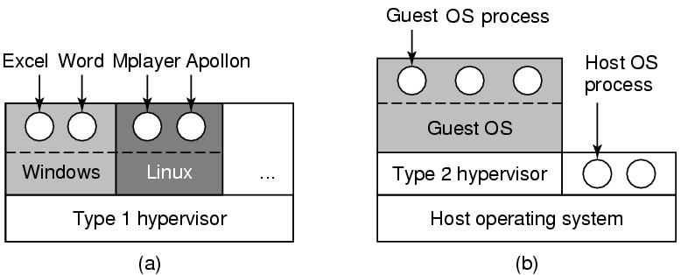
Virtual Machines (2)
(a) A type 1 hypervisor. (b) A type 2 hypervisor.
Tanenbaum, Modern Operating Systems 3 e, (c) 2008 Prentice-Hall, Inc. All rights reserved. 0-13-6006639

Slide 62
Computing Environments – Cloud Computing
Delivers computing, storage, even apps as a service across a network
Logical extension of virtualization as based on virtualization
Amazon EC2 has thousands of servers, millions of VMs, PBs of storage available across the Internet, pay based on usage
Many types
Public cloud – available via Internet to anyone willing to pay
Private cloud – run by a company for the company’s own use
Hybrid cloud – includes both public and private cloud components
Software as a Service (SaaS) – one or more applications available via the Internet (i.e. word processor)
Platform as a Service (PaaS) – software stack ready for application use via the Internet (i.e a database server)
Infrastructure as a Service (IaaS) – servers or storage available over Internet (i.e. storage available for backup use)

Slide 63
Computing Environments – Cloud Computing
Cloud compute environments composed of traditional OSes, plus VMMs, plus cloud management tools
Internet connectivity requires security like firewalls
Load balancers spread traffic across multiple applications

Slide 64
Kernel Data Structures
Many similar to standard programming data structures
Singly linked list
Doubly linked list
Circular linked list

Slide 65
Kernel Data Structures
Binary search tree left <= right
Search performance is O(n)
Balanced binary search tree is O(lg n)

Slide 66
Kernel Data Structures
Hash function can create a hash map
Bitmap – string of n binary digits representing the status of n items
Linux data structures defined in include files <linux/list.h>,<linux/kfifo.h>, <linux/rbtree.h>

Slide 67
System Structures

Slide 68
Operating System Services (Cont.)
Another set of OS functions exists for ensuring the efficient operation of the system itself via resource sharing
Resource allocation - When multiple users or multiple jobs running concurrently, resources must be allocated to each of them
Many types of resources - Some (such as CPU cycles, main memory, and file storage) may have special allocation code, others (such as I/O devices) may have general request and release code
Accounting - To keep track of which users use how much and what kinds of computer resources
Protection and security - The owners of information stored in a multiuser or networked computer system may want to control use of that information, concurrent processes should not interfere with each other
Protection involves ensuring that all access to system resources is controlled
Security of the system from outsiders requires user authentication, extends to defending external I/O devices from invalid access attempts
If a system is to be protected and secure, precautions must be instituted throughout it. A chain is only as strong as its weakest link.
Notes:
68

Slide 69
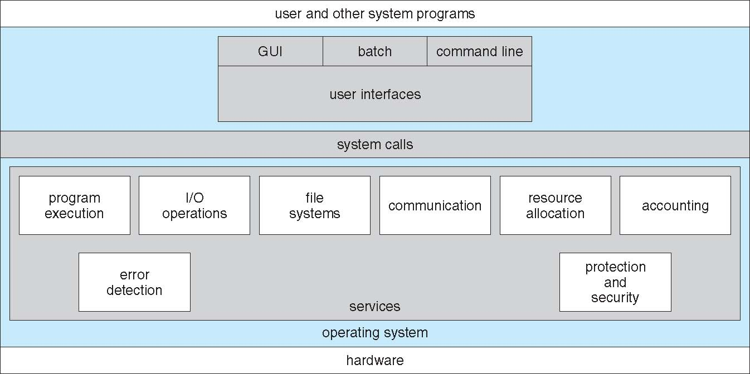
A View of Operating System Services

Slide 70
System calls
System calls is the interface users contact with OS and hardware
System calls vary from system to system, but the underlying concepts are similar

Slide 71
System Calls
Typically written in a high-level language (C or C++)
Mostly accessed by programs via a high-level Application Program Interface (API) rather than direct system call use
Three most common APIs are Win32 API for Windows, POSIX API for POSIX-based systems (including virtually all versions of UNIX, Linux, and Mac OS X), and Java API for the Java virtual machine (JVM)
Notes:
71

Slide 72
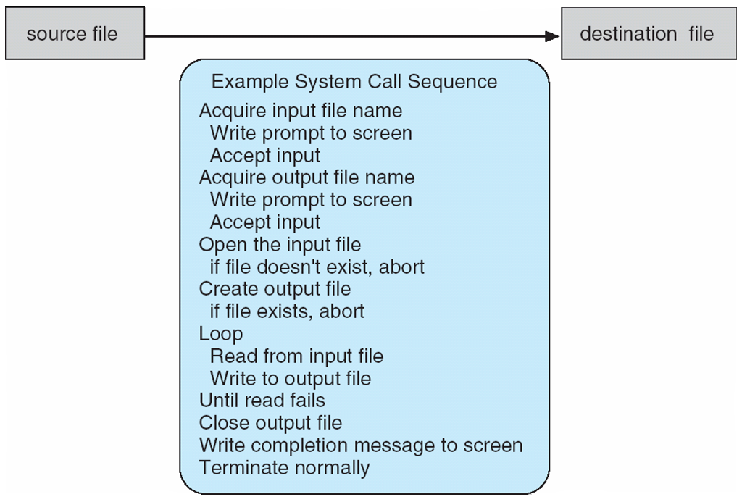
Example of System Calls
System call sequence to copy the contents of one file to another file
Notes:
72

Slide 73
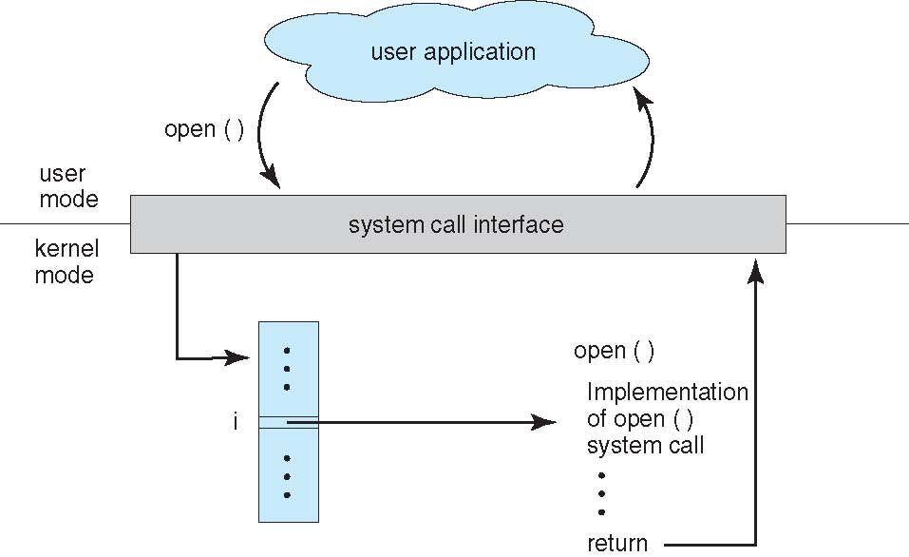
API – System Call – OS Relationship
Notes:
73

Slide 74
System Call Implementation
Typically, a number associated with each system call
System-call interface maintains a table indexed according to these numbers
The system call interface invokes intended system call in OS kernel and returns status of the system call and any return values
The caller need know nothing about how the system call is implemented
Notes:
74

Slide 75
System Call Parameter Passing
Three general methods used to pass parameters to the OS
Simplest: pass the parameters in registers
Sometimes, may be more parameters than registers
Parameters stored in a block, or table, in memory, and address of block passed as a parameter in a register
This approach taken by Linux and Solaris
Parameters placed, or pushed, onto the stack by the program and popped off the stack by the operating system
Block and stack methods do not limit the number or length of parameters being passed
Notes:
75

Slide 76
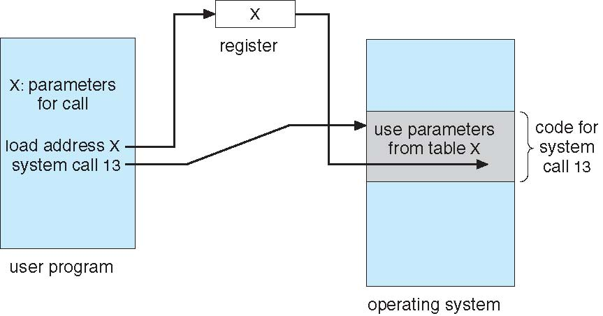
Parameter Passing via Table
Notes:
76

Slide 77
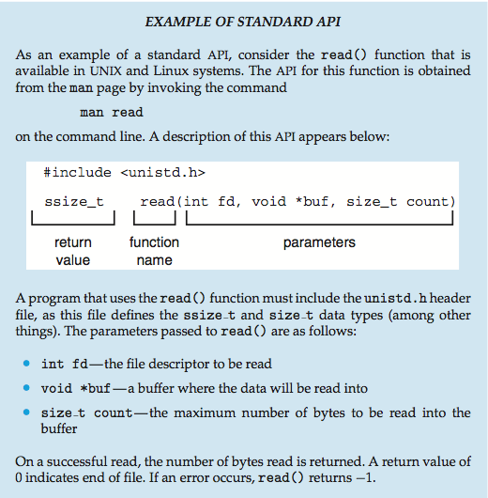
Example of Standard API
Notes:
77

Slide 78
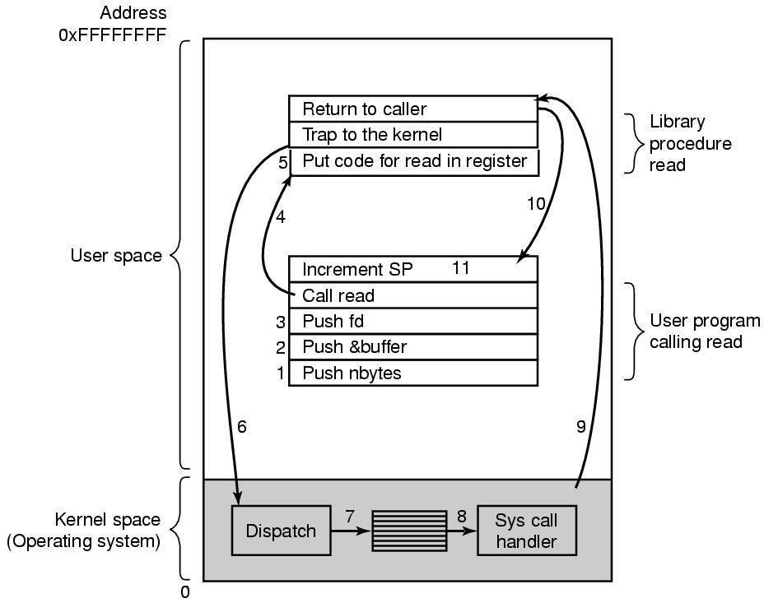
System Calls
The calling program first pushes the parameters onto the stack
Executes a TRAP instruction to switch from user mode to kernel mode and start execution at a fixed address within the kernel
The 11 steps in making the system call read(fd, buffer, nbytes).
Tanenbaum, Modern Operating Systems 3 e, (c) 2008 Prentice-Hall, Inc. All rights reserved. 0-13-6006639

Slide 79
Actual call to the library procedure
Trap either jumps to a single fixed location or there is an 8-bit field in the instruction giving the index into a table in memory containing jump addresses
The kernel code that starts following the TRAP examines the system-call number and then dispatches to the correct system-call handler, usually via a table of pointers to system-call handlers indexed on system-call number.
At that point the system-call handler runs.
Once it has completed its work, control may be returned to the user-space library procedure at the instruction following the TRAP instruction.

Slide 80
Types of System Calls
Process control
end, abort
load, execute
create process, terminate process
get process attributes, set process attributes
wait for time
wait event, signal event
allocate and free memory
Dump memory if error
Debugger for determining bugs, single step execution
Locks for managing access to shared data between processes
Notes:
80

Slide 81
Types of System Calls
File management
create file, delete file
open, close file
read, write, reposition
get and set file attributes
Device management
request device, release device
read, write, reposition
get device attributes, set device attributes
logically attach or detach devices
Notes:
81

Slide 82
Types of System Calls (Cont.)
Information maintenance
get time or date, set time or date
get system data, set system data
get and set process, file, or device attributes
Communications
create, delete communication connection
send, receive messages if message passing model to host name or process name
From client to server
Shared-memory model create and gain access to memory regions
transfer status information
attach and detach remote devices
Notes:
82

Slide 83
Types of System Calls (Cont.)
Protection
Control access to resources
Get and set permissions
Allow and deny user access
Notes:
83

Slide 84
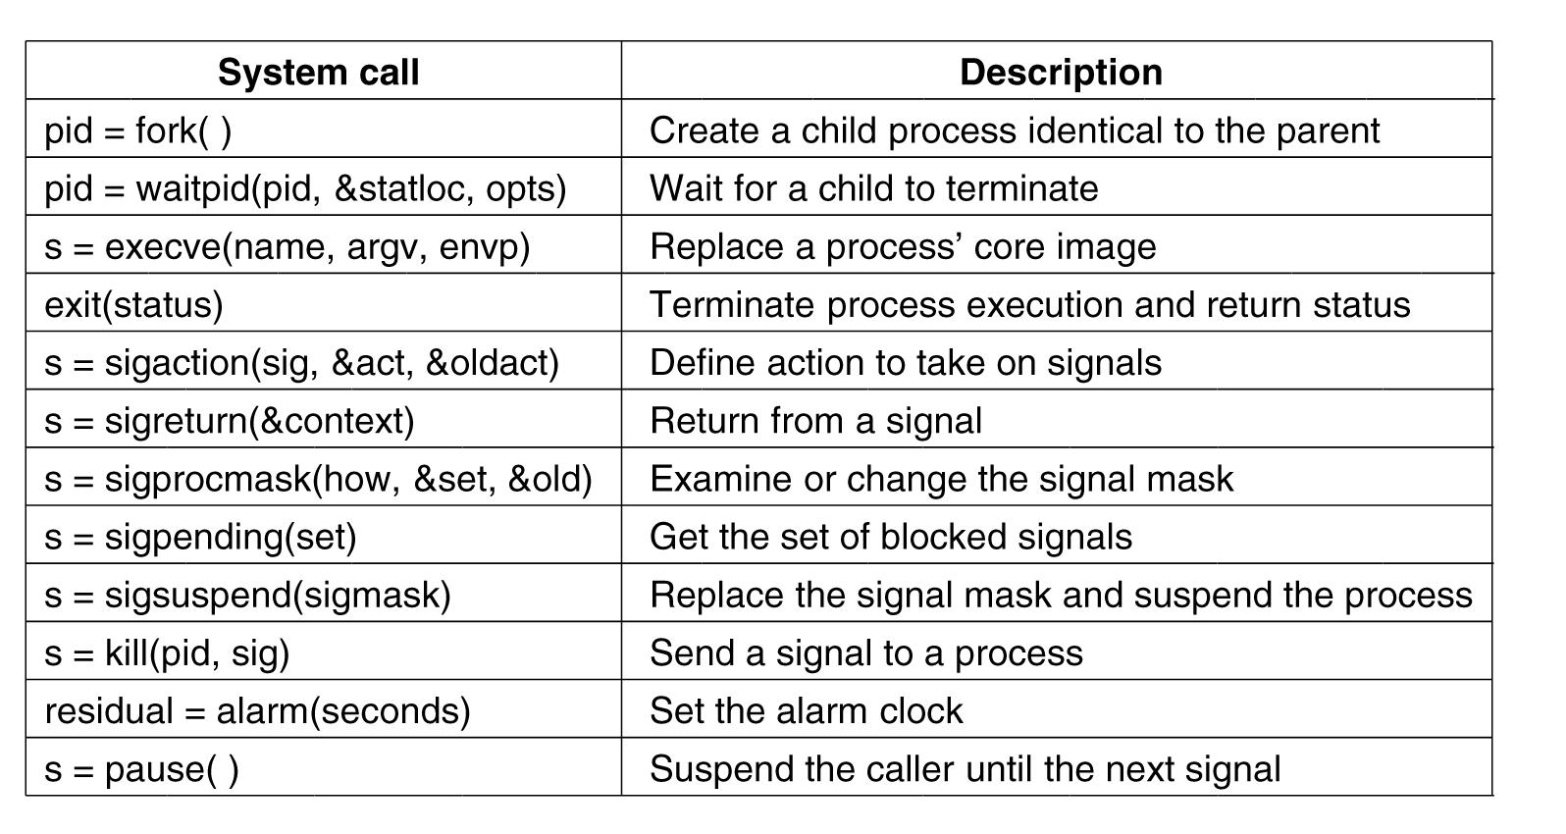
Process Management System Calls in Linux
Some system calls relating to processes.
Tanenbaum, Modern Operating Systems 3 e, (c) 2008 Prentice-Hall, Inc. All rights reserved. 0-13-6006639

Slide 85
System Calls for File Management (1)
Tanenbaum, Modern Operating Systems 3 e, (c) 2008 Prentice-Hall, Inc. All rights reserved. 0-13-6006639

Slide 86
System Calls for File Management (2)
Tanenbaum, Modern Operating Systems 3 e, (c) 2008 Prentice-Hall, Inc. All rights reserved. 0-13-6006639

Slide 87
Miscellaneous System Calls
Tanenbaum, Modern Operating Systems 3 e, (c) 2008 Prentice-Hall, Inc. All rights reserved. 0-13-6006639

Slide 88
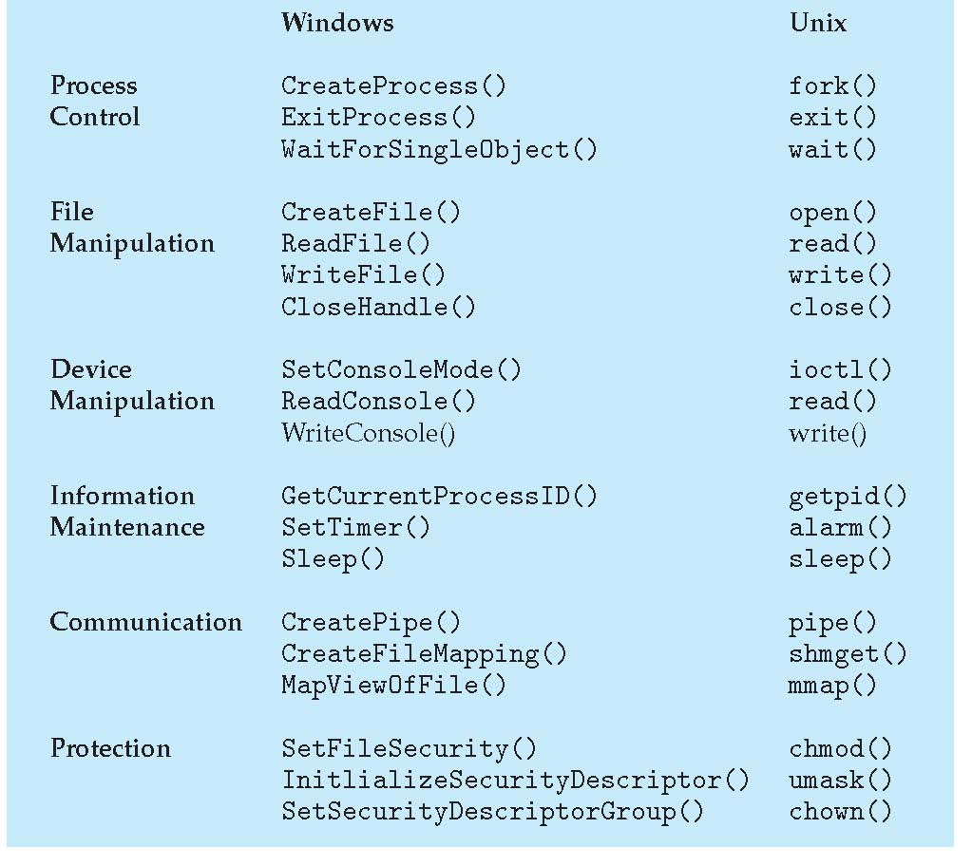
Examples of Windows and Unix System Calls

Slide 89
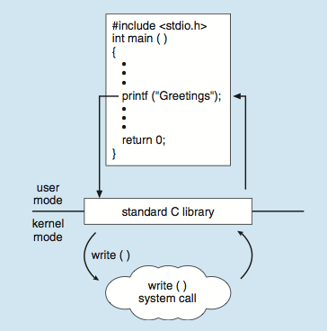
Standard C Library Example
C program invoking printf() library call, which calls write() system call
Notes:
89

Slide 90
Signals
Are notifications (software interrupt) sent to a running process in order to notify it of various "important or exceptional" events.
By their nature, they interrupt whatever the process is doing at this minute, and force it to handle them immediately.
Signals can be initiated by programs, users, or administrators.
Each signal has an integer number that represents it (1, 2 and so on), as well as a symbolic name that is usually defined in the file /usr/include/signal.h or one of the files included by it directly or indirectly
(HUP, INT and so on. Use the command 'kill -l' to see a list of signals supported by your system).

Slide 91
Signals Handler
Each signal may have a signal handler, which is a function that gets called when the process receives that signal.
The function is called in "asynchronous mode", meaning that no where in your program you have code that calls this function directly.
Instead, when the signal is sent to the process, the operating system stops the execution of the process, and "forces" it to call the signal handler function.
When that signal handler function returns, the process continues execution from wherever it happened to be before the signal was received, as if this interruption never occurred.
Each Unix signal has a default set of effects on a Unix program.
A signal stack is a special area of memory to be used as the execution stack during signal handlers.

Slide 92
Default Effect of Signal
Each signal has a current disposition, which determines how the process behaves when it is delivered the signal i.e. action associated with a signal.
Ignore / Catch / Let Default Action Apply
Using sigaction/signal system calls, a process can elect one of the following behaviors to occur on delivery of the signal:
Perform the default action;
Ignore the signal;
or Catch the signal with a signal handler, a programmer-defined function that is automatically invoked when the signal is delivered.
https://www.gnu.org/software/libc/manual/html_node/index.html#SEC_Contents

Slide 93
Signals Handlers …
Programmers can code their applications to respond in customized ways to most signals.
By default, a signal handler is invoked on the normal process stack.
It is possible to arrange that the signal handler uses an alternate stack i.e. programmers can customize signal handlers.
Two signals are unable to be redefined by a signal handler.
SIGKILL always stops a process and SIGSTOP always moves a process from the foreground to the background.
These two signals cannot be "caught" by a signal handler.

Slide 94
Sending Signals Using The Keyboard
The most common way of sending signals to processes is using the keyboard.
There are certain key presses that are interpreted by the system as requests to send signals to the process with which we are interacting:
Ctrl-C Pressing this key causes the system to send an INT signal (SIGINT) to the running process.
By default, this signal causes the process to immediately terminate.

Slide 95
Sending Signals Using The Keyboard …
Ctrl-Z Pressing this key causes the system to send a TSTP signal (SIGTSTP) to the running process.
By default, this signal causes the process to suspend execution.
Ctrl-\ Pressing this key causes the system to send a ABRT signal (SIGABRT) to the running process.
By default, this signal causes the process to immediately terminate.

Slide 96
Sending Signals From Command Line (internal to shell)
kill The kill command accepts two parameters: a signal name (or number), and a process ID.
kill -<signal> <PID>
For example, in order to send the INT signal to process with PID 5342, type:
kill -INT 5342
This has the same affect as pressing Ctrl-C in the shell that runs that process.
If no signal name or number is specified, the default is to send a SIGTERM signal to the process, which normally causes its termination, and hence the name of the kill command.
If SIGTERM fails, we can escalate to using the SIGKILL signal to stop the process:
kill -9 4140
Because SIGKILL cannot be handled, stopping a process with SIGKILL is generally considered a bad idea. Using SIGKILL prevents a process from cleaning up after itself and exiting gracefully.
fg On most shells, using the 'fg' command will resume execution of the process (that was suspended with Ctrl-Z), by sending it a CONT signal.

Slide 97
Catchable And Non-Catchable Signals
SIGKILL signal (kill -9 command in Unix) is such a signal. This is used to shut down using this signal if it gets "wild".
One process that uses this signal is a system shutdown process. It first sends a TERM signal to all processes, waits a while, and after allowing them a "grace period" to shut down cleanly, it kills whichever are left using the KILL signal.
SIGSTOP is also a signal that a process cannot catch, and forces the process's suspension immediately.
This is useful when debugging programs whose behavior depends on timing.

Slide 98
More on Kill
For a 'polite' stop to the process, send SIGTSTP:
kill -TSTP [pid]
For a 'hard' stop, send SIGSTOP:
kill -STOP [pid]
To resume execution of the process, sent SIGCONT:
kill -CONT [pid]
https://www.gnu.org/software/libc/manual/html_node/Job-Control-Signals.html

Slide 99
Important
Like KILL, STOP can’t be caught, blocked, or ignored: it always stops the receiving process.
TSTP on the other hand can be ignored or handled in a different way; for example, shells, and Emacs, set up TSTP handlers to deal with Ctrl-Z themselves.
This behaviour in shells ensures that pressing Ctrl-Z is always safe, and won’t get you stuck in a terminal with a stopped process and no way of resuming it.

Slide 100
Example
#include <stdio.h> /* standard I/O functions */
#include<unistd.h> /*standard unix functions, e.g. getpid()*/
#include <signal.h> /* signal name macros, signal() prototype */
/* first, here is the signal handler */
void catch_int(int sig_num)
{
/* re-set the signal handler again to catch_int, for next time */
signal(SIGINT, catch_int);
printf("Don't do that\n");
fflush(stdout);
}
int main(int argc, char* argv[])
{
/* set the INT (Ctrl-C) signal handler to 'catch_int' */
signal(SIGINT, catch_int);
for ( ;; )
pause();
}

Slide 101
Signal Types
Maskable: signals which can be changed or ignored by the user (e.g., Ctrl+C).
Non-Maskable: signals which cannot be changed or ignored by the user. These typically occur when the user is signaled for non-recoverable hardware errors.

Slide 102
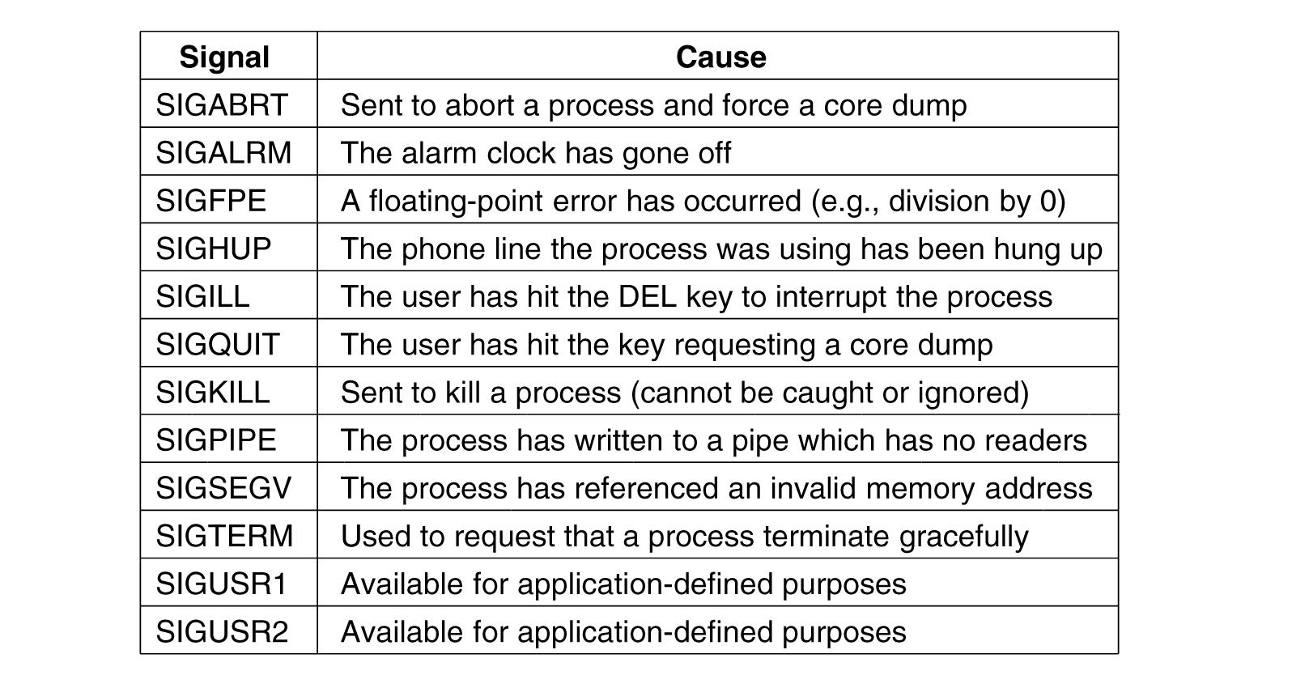
Signals in Linux (1)
The signals required by POSIX.
Tanenbaum, Modern Operating Systems 3 e, (c) 2008 Prentice-Hall, Inc. All rights reserved. 0-13-6006639

Slide 103
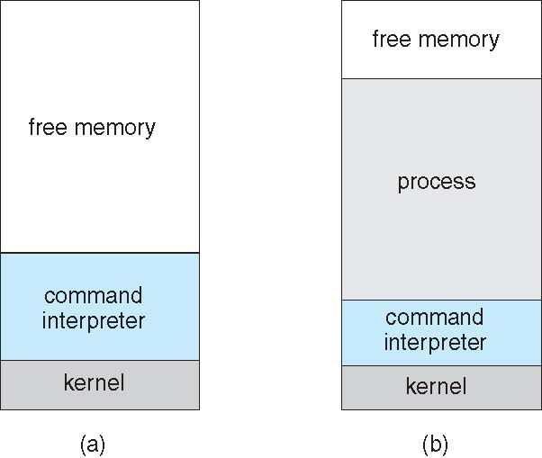
Example: MS-DOS
Single-tasking
Shell invoked when system booted
Simple method to run program
No process created
Single memory space
Loads program into memory, overwriting all but the kernel
Program exit -> shell reloaded
(a) At system startup (b) running a program

Slide 104
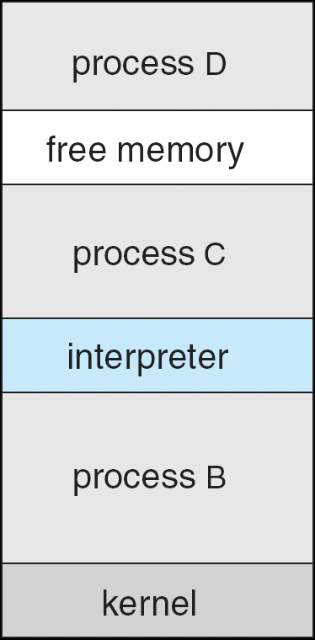
Example: FreeBSD
Unix variant
Multitasking
User login -> invoke user’s choice of shell
Shell executes fork() system call to create process
Executes exec() to load program into process
Shell waits for process to terminate or continues with user commands
Process exits with code of 0 – no error or > 0 – error code

Slide 105
System Programs
System programs provide a convenient environment for program development and execution.
Notes:
105

Slide 106
System Programs
Most users’ view of the operating system is defined by system programs, not the actual system calls
File management - Create, delete, copy, rename, print, dump, list, and manipulate files and directories
Status information
Some ask the system for info - date, time, amount of available memory, disk space, number of users
Others provide detailed performance, logging, and debugging information
Typically, these programs format and print the output to the terminal or other output devices
Some systems implement a registry - used to store and retrieve configuration information
Notes:
106

Slide 107
System Programs (Cont.)
File modification
Text editors / commands to search contents of files or perform transformations of the text
Programming-language support - Compilers, assemblers, debuggers and interpreters
Program loading and execution- Absolute loaders, relocatable loaders, linkage editors, and overlay-loaders, debugging systems for higher-level and machine language
Communications - Provide the mechanism for creating virtual connections among processes, users, and computer systems
Notes:
107

Slide 108
System Programs (Cont.)
Background Services
Launch at boot time
Some for system startup, then terminate
Some from system boot to shutdown
Provide facilities like disk checking, process scheduling, error logging, printing
Run in user context not kernel context
Known as services, subsystems, daemons
Notes:
108

Slide 109
MS Windows Registry
It is a central hierarchical database used in MS Windows to store information that is necessary to configure the system for one or more users, applications, and hardware devices.
Registry contains information that Windows continually references during operation, such as profiles for each user, the applications installed on the computer and the types of documents that each can create, property sheet settings for folders and application icons, what hardware exists on the system, and the ports that are being used.
The kernel, device drivers, services, Security Accounts Manager, and user interface can all use the registry.
Alternatively applications may use XML files for keeping configuration information

Slide 110
Operating System Structure
General-purpose OS is very large program

Slide 111
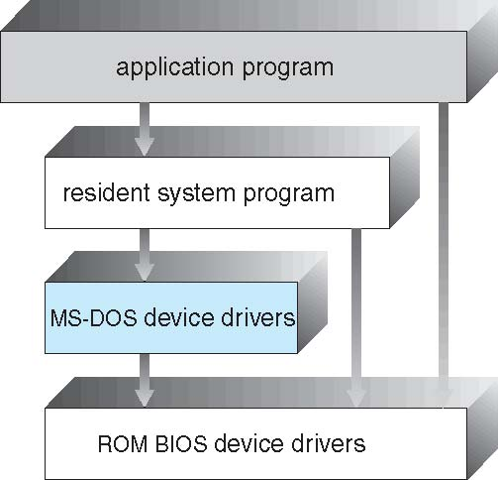
Simple Structure
MS-DOS – written to provide the most functionality in the least space
Not divided into modules
Although MS-DOS has some structure, its interfaces and levels of functionality are not well separated
Notes:
111

Slide 112
UNIX
UNIX – limited by hardware functionality, the original UNIX operating system had limited structuring.
The UNIX OS consists of two separable parts
Systems programs
The kernel
Consists of everything below the system-call interface and above the physical hardware
Provides the file system, CPU scheduling, memory management, and other operating-system functions; a large number of functions for one level
Notes:
112

Slide 113
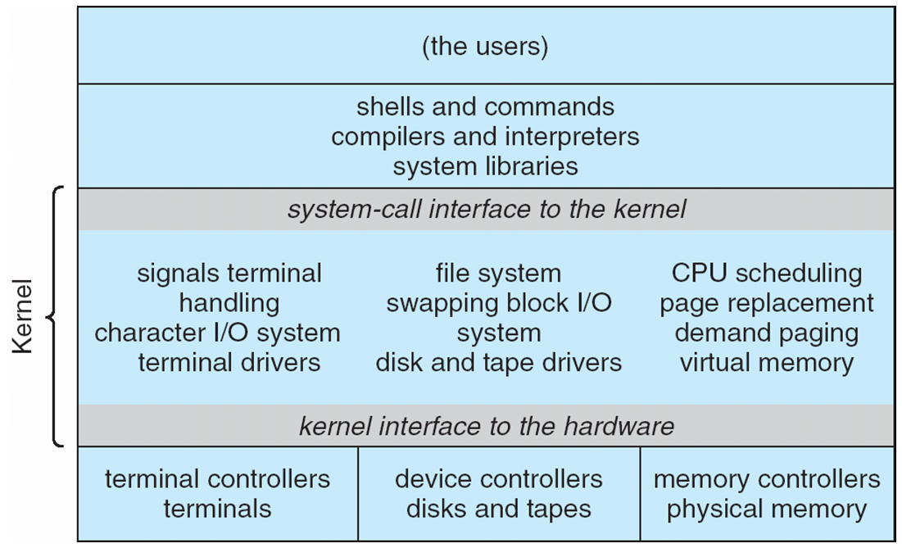
Traditional UNIX System Structure
Beyond simple but not fully layered
Notes:
113

Slide 114
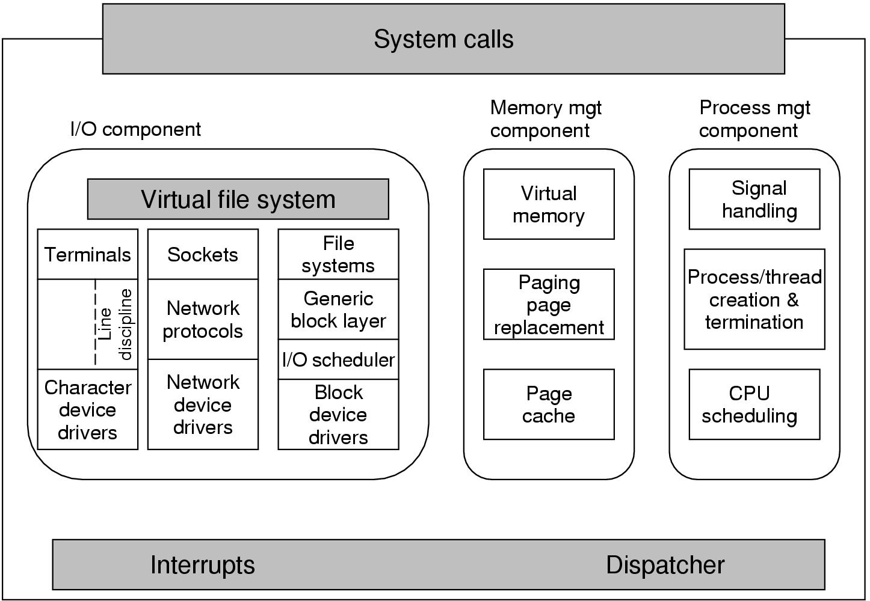
Structure of the Linux kernel
Tanenbaum, Modern Operating Systems 3 e, (c) 2008 Prentice-Hall, Inc. All rights reserved. 0-13-6006639

Slide 115
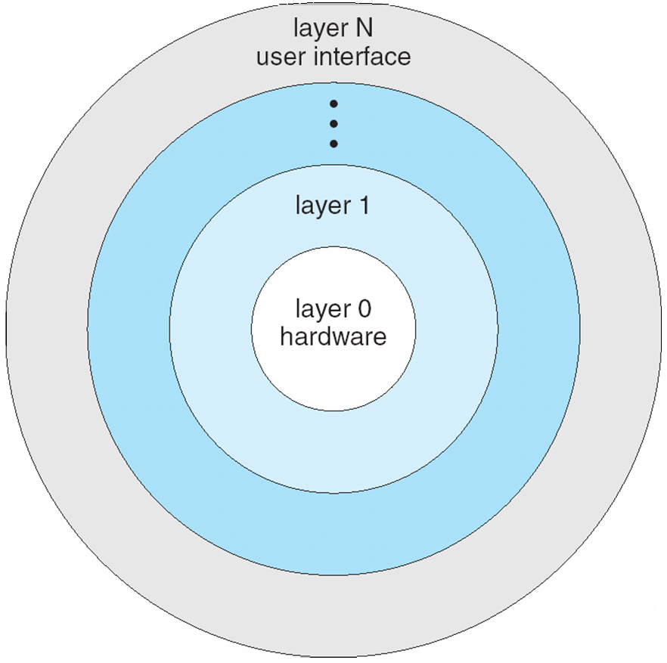
Layered Approach
The operating system is divided into a number of layers (levels), each built on top of lower layers. The bottom layer (layer 0), is the hardware; the highest (layer N) is the user interface.
With modularity, layers are selected such that each uses functions (operations) and services of only lower-level layers
Notes:
115

Slide 116
Microkernel System Structure
Moves as much from the kernel into user space
Mach example of microkernel.
Mac OS X kernel (Darwin) partly based on Mach.
Communication takes place between user modules using message passing.
Benefits:
Easier to extend a microkernel
Easier to port the operating system to new architectures
More reliable (less code is running in kernel mode)
More secure
Detriments:
Performance overhead of user space to kernel space communication
Notes:
116

Slide 117
Microkernel System Structure
Notes:
117

Slide 118
Modules
Most modern operating systems implement loadable kernel modules.
Uses object-oriented approach
Each core component is separate
Each talks to the others over known interfaces
Each is loadable as needed within the kernel
Overall, similar to layers but with more flexible.
Linux, Solaris, etc
Notes:
118

Slide 119
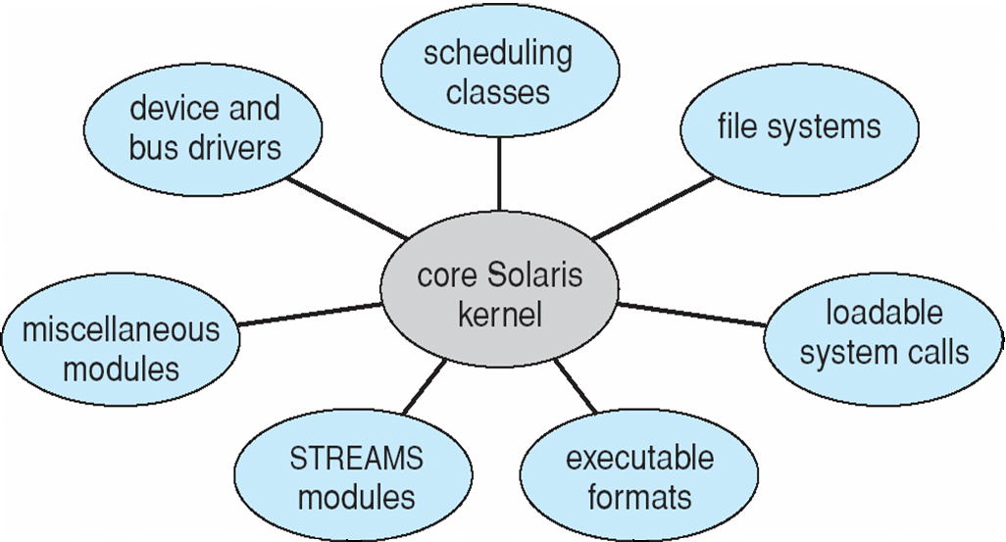
Solaris Modular Approach
Notes:
119

Slide 120
Hybrid Systems
Most modern operating systems actually not one pure model
Hybrid combines multiple approaches to address performance, security, usability needs
Linux and Solaris kernels in kernel address space, so monolithic, plus modular for dynamic loading of functionality
Windows mostly monolithic, plus microkernel for different subsystem personalities
Apple Mac OS X hybrid, layered, Aqua UI plus Cocoa programming environment
Kernel consists of Mach microkernel and BSD Unix parts, plus I/O kit and dynamically loadable modules (called kernel extensions)
Notes:
120

Slide 121
Mac OS X Structure

Slide 122
iOS
Apple mobile OS for iPhone, iPad
Structured on Mac OS X, added functionality
Does not run OS X applications natively
Also runs on different CPU architecture (ARM vs. Intel)
Cocoa Touch Objective-C API for developing apps
Media services layer for graphics, audio, video
Core services provides cloud computing, databases
Core operating system, based on Mac OS X kernel
Notes:
122

Slide 123
Android
Developed by Open Handset Alliance (mostly Google): Purchased by Google in 2005
AOSP
Similar stack to IOS
Based on Linux kernel but modified
Provides process, memory, device-driver management
Adds power management
Runtime environment includes core set of libraries and Dalvik virtual machine
Apps developed in Java plus Android API
Java class files compiled to Java bytecode then translated to executable than runs in Dalvik VM
Libraries include frameworks for web browser (webkit), database (SQLite), multimedia, smaller libc
Notes:
123

Slide 124
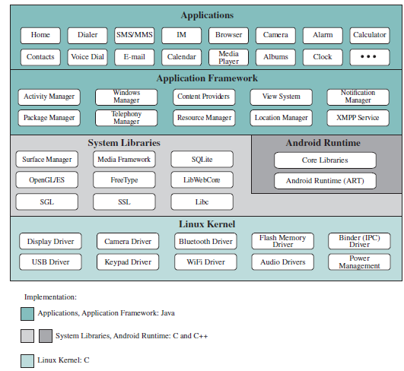
Android Architecture
Notes:
124

Slide 125
Android Linux Kernel
Android kernel lacks drivers not applicable in mobile environments, making the kernel smaller.
In addition, Android enhances the Linux kernel with features that are tailored to the mobile environment, and generally not as useful or applicable on a desktop or laptop platform.

Slide 126
Android Runtime Concepts (ART)
Current application runtime used by Android, introduced with Android version 4.4 (KitKat).
When Android was designed initially, it was designed for single core (with minimal multithreading support in hardware) and low-memory devices
All Android applications written in Java are compiled to dex bytecode.
While Dalvik uses dex bytecode format for portability, it has to be converted (compiled) to machine code to be actually run by a processor.
The Dalvik runtime did this conversion from dex bytecode to native machine code when the application ran, and this process was called JIT (just-in-time) compilation.
Because JIT compiles only a part of the code, it has a smaller memory footprint and uses less physical space on the device

Slide 127
Dalvik vs ART
Dalvik has to do JIT-compilation every time the app is run, which consumes a considerable amount of processor resources.
ART also executes dex bytecode but instead of compiling the bytecode at runtime, ART compiles the bytecode to native machine code during install time of the app.
This is called aheadof-time (AOT) compilation.
ART uses the “dex2oat” tool to do this compilation at install time.
The output of the tool is a file that is then executed when the application runs.

Slide 128
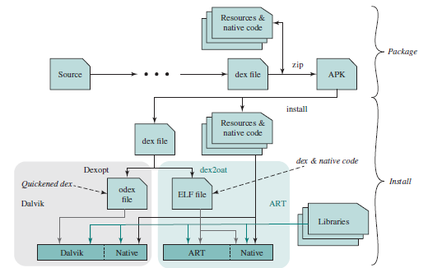
Life cycle of an APK
The cycle begins with source code being compiled into .dex format and combined with any appropriate support code to form an APK.
On the user side, the received APK is unpacked.
The resources and native code are generally installed directly into the application directory.
The output of the dex2oat function is an Executable and Linkable Format (ELF) file, which runs directly without an interpreter.

Slide 129
System Libraries
The layer below the Application Framework consists of two parts: System Libraries, and Android Runtime.
The System Libraries component is a collection of useful system functions, written in C or C+ + and used by various components of the Android system.
They are called from the application framework and applications through a Java interface.
These features are exposed to developers through the Android application framework.

Slide 130
System Libraries
Surface Manager: Android uses a compositing window manager similar to Vista or Compiz, but it is much simpler.
Instead of drawing directly to the screen buffer, drawing commands go into off-screen bitmaps that are then combined with other bitmaps to form the screen content.
Create interesting effects, such as see-through windows
OpenGL: OpenGL (Open Graphics Library) is a cross-language, multiplatform API for rendering 2D and 3D computer graphics.
OpenGL/ES (OpenGL for embedded systems) is a subset of OpenGL designed for embedded systems.
Media Framework: The Media Framework supports video recording and playing in many formats, including AAC, AVC (H.264), H.263, MP3, and MPEG-4.

Slide 131
System Libraries
SQL Database: Android includes a lightweight SQLite database engine for storing persistent data.
Browser Engine: For fast display of HTML content, Android uses the WebKit library, which is essentially the same library used in Safari and iPhone.
It was also the library used for the Google Chrome browser until Google switched to Blink.
Bionic LibC: This is a stripped-down version of the standard C system library, tuned for embedded Linux-based devices.
The interface is the standard Java Native Interface (JNI).

Slide 132
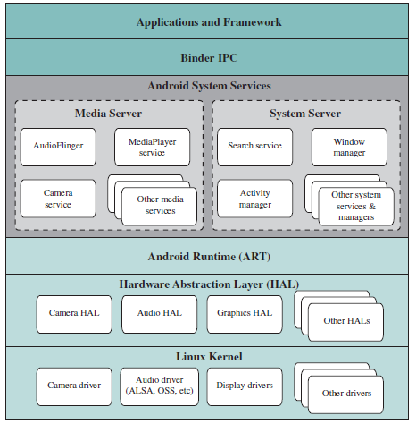
Android System Architecture

Slide 133
Operating-System Debugging
Debugging is finding and fixing errors, or bugs
OSes generate log files containing error information
Failure of an application can generate core dump file capturing memory of the process
Operating system failure can generate crash dump file containing kernel memory
Beyond crashes, performance tuning can optimize system performance
Sometimes using trace listings of activities, recorded for analysis
Profiling is periodic sampling of instruction pointer to look for statistical trends

Slide 134
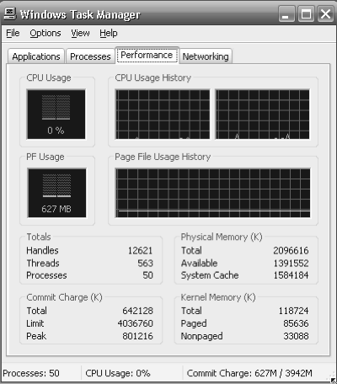
OS Performance Tuning
Improve performance by removing bottlenecks
OS must provide means of computing and displaying measures of system behavior
For example, “top” program or Windows Task Manager

Slide 135
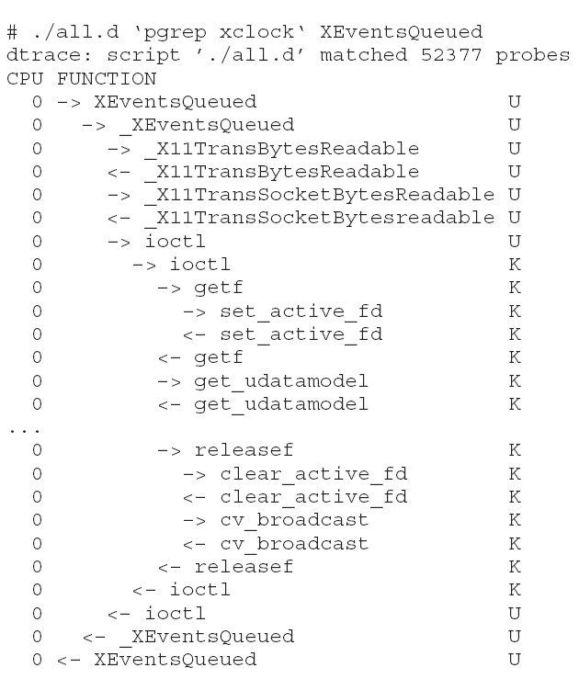
Dtrace: Performance analysis and Troubleshooting tool
DTrace tool in Solaris, FreeBSD, Mac OS X allows live instrumentation on production systems
Probes fire when code is executed within a provider, capturing state data and sending it to consumers of those probes
Example of following XEventsQueued system call move from libc library to kernel and back
Notes:
135

Slide 136
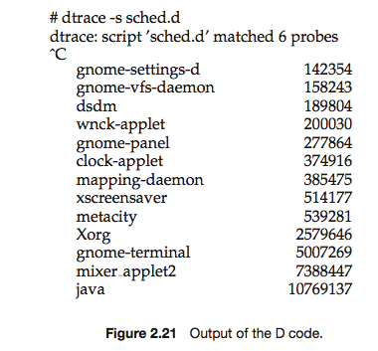
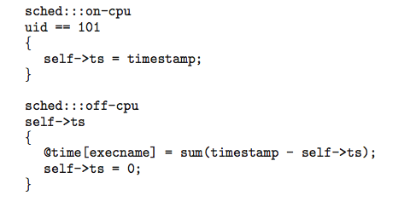
DTrace
DTrace code to record amount of time each process with UserID 101 is in running mode (on CPU) in nanoseconds
Notes:
136

Slide 137
Operating System Generation
Operating systems are designed to run on any of a class of machines; the system must be configured for each specific computer site
SYSGEN program obtains information concerning the specific configuration of the hardware system
Used to build system-specific compiled kernel or system-tuned
Can general more efficient code than one general kernel
Combine user-specified options and parameters with manufacturer-supplied general-purpose program code to produce an operating system tailored for a particular hardware and software environment.
Notes:
137

Slide 138
System Boot
When power initialized on system, execution starts at a fixed memory location
Firmware ROM used to hold initial boot code
Operating system must be made available to hardware so hardware can start it
Small piece of code – bootstrap loader, stored in ROM or EEPROM locates the kernel, loads it into memory, and starts it
Sometimes two-step process where boot block at fixed location loaded by ROM code, which loads bootstrap loader from disk
Common bootstrap loader, GRUB, allows selection of kernel from multiple disks, versions, kernel options
Kernel loads and system is then running
Notes:
138

Slide 139
Boot up phases
There are 4 phases to starting up the system:
BIOS
Boot loader
Kernel
Upstart (which manages system tasks and services )

Slide 140
Core Boot Tasks Started by Upstart
Plymouth - The graphical boot animation and logger
mountall - Mounts all filesystems defined on /etc/fstab
network* - Network related services
Display Manager (GDM,KDM,XDM,...)
(upstart tasks/services are configured at /etc/init)

Slide 141
BIOS Phase
When the computer begins execution, it starts by executing this code, which is also called the firmware, as it is normally stored in a permanent form of memory, such as ROM, on the computer's motherboard.
On a Macintosh computer this is the OpenFirmware.
This code must initialize the hardware other than the CPU, and obtain the code for the next step, the boot loader.
Modern computers provide several possibilities for the boot loader and the choice is normally set on the BIOS startup screen.

Slide 142
Boot Loader Phase
There are several possible types of boot loaders and ways for the BIOS to obtain them.
A boot loader stored in the first sector of a hard disk, the Master Boot Record, or MBR.
This may be GRUB or LILO or yaboot or others.
A boot loader stored on some other storage device, such as a CDR or USB flash drive.
A boot loader which uses the network, such as the Pre-Execution Environment (PXE).
This code is normally stored on a ROM on the networking card itself.
The job of the boot loader is to begin the next phase, loading the kernel and an initial ram disk filesystem.

Slide 143
Kernel Phase
The bootloader starts the kernel running.
To keep kernels to a reasonable size and permit separate modules for separate hardware, modern kernels also use a file system which is present in memory, called an 'initrd' for 'initial ram disk'.
Both the kernel file to load and the initial ram disk are normally specified as options to the boot loader.
The kernel launches the init script inside the initrd file system, which loads hardware drivers and finds the root partition.

Slide 144
System startup
After the kernel is running, the remainder of the operating system is brought online.
First the root partition and filesystem is located, checked and mounted.
Next the init process is started, which runs the initialization scripts.
These scripts involve different /etc/rc scripts and upstart events that eventually gives you a ready-to-use computer with a login screen.
The root partition with the operating system can be somewhere completely different than the kernel, for instance on another drive or on a remote computer.

